Slide 1
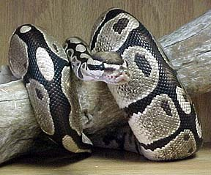
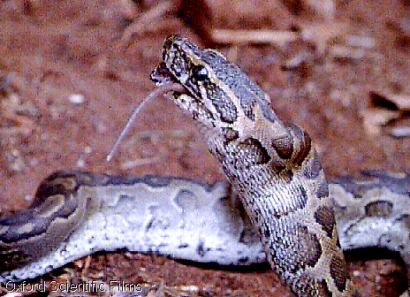
Closed Loop Temporal Sequence Learning
Learning to act in response to
sequences of sensor events

Slide 2
Overview over different methods
You are here !

Slide 3
Natural Temporal Sequences in life and
in “control” situations
Real Life
Heat radiation predicts pain when touching a hot surface.
Sound of a prey may precede its smell will precede its taste.
Control
Force precedes position change.
Electrical (disturbance) pulse may precede change in a controlled plant.
Psychological Experiment
Pavlovian and/or Operant Conditioning: Bell precedes Food.

Slide 4

What we had so far !
Early: “Bell”
x
ω
Σ
Late: “Food”

Slide 5
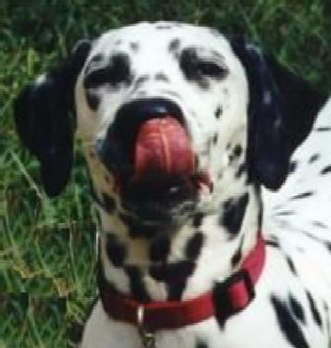
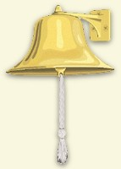
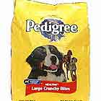
conditioned
Input
Sensor 2
This is an open-loop
system
Pavlov, 1927
This is an Open Loop System !
Bell
Food
Salivation
Temporal Sequence

Slide 6
Closed loop
Sensing
Behaving
Adaptable
Neuron
Env.

Slide 7
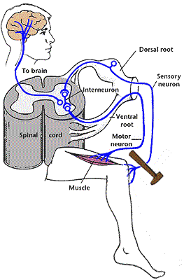
How to assure behavioral & learning convergence ??
This is achieved by starting with a stable reflex-like action
and learning to supercede it by an anticipatory action.
Remove before
being hit !

Slide 8
Robot Application
x
Early: “Vision”
ω
Σ
Late: “Bump”

Slide 9
Reflex Only
(Compare to an electronic closed loop controller!)
Think of a Thermostat !
This structure assures initial (behavioral) stability (“homeostasis”)

Slide 10
Bump
Retraction
reflex
This is a closed-loop
system before learning
The Basic Control Structure
Schematic diagram of
A pure reflex loop

Slide 11
Robot Application
Learning Goal:
Correlate the vision signals
with the touch signals and
navigate without collisions.
Initially built-in behavior:
Retraction reaction whenever
an obstacle is touched.

Slide 12
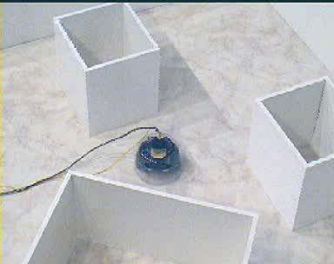
Lets look at the Reflex first

Slide 13
This is an open-loop
system
The T represents the temporal delay between vision and bump.
This is a closed-loop
system before learning
This is a closed-loop
system during learning
Closed Loop
TS Learning

Slide 14
Lets see how learning continues

Slide 15
Antomically this loop still
exists but ideally it should
never be active again !
This is the system
after learning
Closed Loop
TS Learning

Slide 16
What has the learning done ?
Elimination of the late reflex input corresponds mathematically to the condition:
X₀=0
This was the major condition of convergence for the ISO/ICO rules. (The other one was T=0).
What’s interesting about this is that the learning-induced behavior self-generates this condition. This is non-trivial as it assures the synaptic weight AND behavior stabilize at exactly the same moment in time.

Slide 17
This is the system
after learning
The inner pathway has
now become a pure
feed-forward path
This is the system after
learning.
What has happened in
engineering terms?

Slide 18
Formally:
Delta pulse Disturbance D
Calculations in the Laplace Domain!

Slide 19
The Learner has learned the inverse transfer function of the world and can compensate the disturbance therefore at the summation node!
-e^{-sT}
0
e^{-sT}
P₁
D
Phase Shift

Slide 20
The out path has, through learning, built a Forward Model of the inner path.
This is some kind of a “holy grail” for an engineer called:
“Model Free Feed-Forward Compensation”
For example: If you want to keep the temperature in an outdoors container constant, you can employ a thermostat.
You may however also first measure how the sun warms the liquid in the container, relating outside temperature to inside temperature (“Eichkurve”).
From this curve you can extract a control signal for the cooling of the liquid and react BEFORE the liquid inside starts warming up.
As you react BEFORE, this is called Feed-Forward-Compensation (FFC).
As you have used a curve, have performed Model-Based FFC.
Our robot learns the model, hence we do Model Free FFC.

